Slide 1
The 3 Colors of community
Topic: Community

Slide 2
Dear presenter, This PowerPoint serves as a master file for creating your own tailored presentations. It’s not designed to be presented from start to finish unless it uniquely suits your audience.
When customising your presentation, consider:
Your audience’s specific needs
Your level of influence with them
The time available (aim for one slide per 5–10 minutes, including Q&A)
Potential distractions in the environment
Slide notes include page references from The 3 Colors of Your Spirituality for preparation. Also, be ready to share personal stories from your experience with the material.
Thank you for your valuable ministry!
Blessings ncd.life

Slide 3
The promise of Matthew 18:20
loving the Lord with your head, hands, and heart
Where two or three are gathered
small group
in My name
holistic
there I am among
them
Christ’s presence/
heaven
Holistic small group
= a gathering in Christ's name
= a window to heaven
Notes:
Pages 4-6 of The 3 Colors of Community contain the teaching associated with this slide.

Slide 4
The deepest level of the Trinitarian Compass
Father
is
is not
is not
God
is
is
Holy Spirit
Son
is not
Notes:
Pages 8-10 of The 3 Colors of Community contain the teaching associated with this slide.

Slide 5
What makes a small group holistic?
head
What do
you think?
holistic
small groups
How do
you feel?
What will
you do?
heart
hands
Notes:
Pages 11-14 of The 3 Colors of Community contain the teaching associated with this slide.

Slide 6
What makes a small group holistic?
Effective structures
Inspiring worship
Gift-based ministry
Empowering leadership
Passionate
spirituality
Need-oriented evangelism
Loving relationships
Notes:
Pages 11-14 of The 3 Colors of Community contain the teaching associated with this slide.

Slide 7
What makes a small group holistic?
Effective structures
VITA ACTIVA
Inspiring worship
Gift-based ministry
Empowering leadership
Passionate
spirituality
Need-oriented evangelism
VITA CONTEMPLATIVA
Loving relationships

Slide 8
Sin—breach of community
relationship to yourself
Luke 10:27
Love the Lord your God…
and love your neighbour…
as you love yourself.
Love the Lord your God…
and love your neighbour…
as you love yourself.
Love the Lord your God…
and love your neighbour…
as you love yourself.
Love the Lord your God…
and love your neighbour…
as you love yourself.
relationship to God
relationship to others
Notes:
Pages 15-17 of The 3 Colors of Community contain the teaching associated with this slide.

Slide 9
The Seven Deadly Sins and Christian Community
Effective structures
relationship to yourself
gluttony
Inspiring worship
relationship to yourself
Gift-based ministry
lust
envy
Empowering leadership
pride
relationship to God
relationship to others
Passionate
spirituality
Need-oriented evangelism
sloth
greed
relationship to God
relationship to others
Loving relationships
anger
Notes:
Pages 18-22 of The 3 Colors of Community contain the teaching associated with this slide.

Slide 10
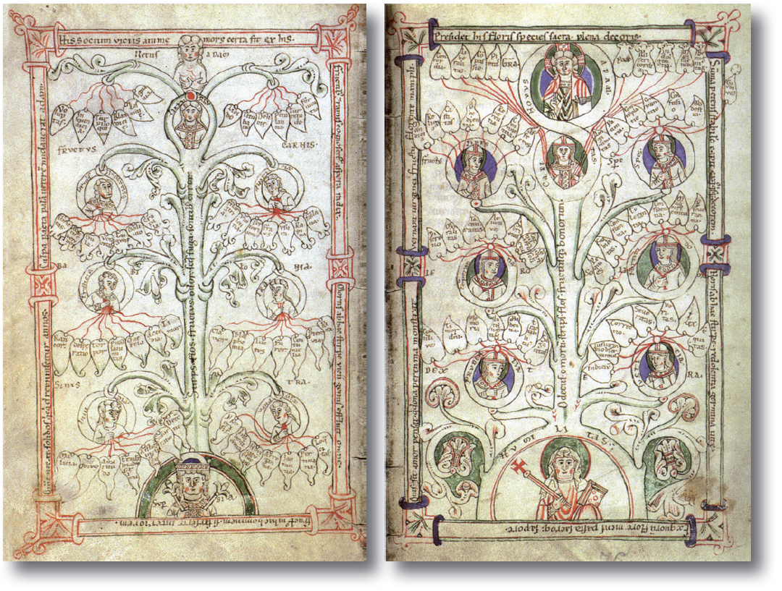
The Seven Deadly Sins and Christian Community
Notes:
Pages 18-22 of The 3 Colors of Community contain the teaching associated with this slide.

Slide 11
Eastern and Western views of sin
Western paradigm
Eastern paradigm
sin as breaking laws
sin as sickness
cure: punishment
cure: healing
church as courtroom
church as hospital
Notes:
Pages 23-26 of The 3 Colors of Community contain the teaching associated with this slide.

Slide 12
Eastern and Western views of sin
Christ’s work:
victory over
opposite of GOOD
opposite of LIFE
&
DEATH
EVIL
emphasis of the Western tradition
emphasis of the Eastern tradition
resulting in the
GOOD
LIFE
Notes:
Pages 23-26 of The 3 Colors of Community contain the teaching associated with this slide.

Slide 13
Harnessing the energies behind the deadly sins
path of
path of
Energy
Sin
denial
compromise
power
pleasure
identity
sustenance
justice
renewal
intimacy
pride
gluttony
envy
greed
anger
sloth
lust
Submit!
Abstain!
Conform!
Renounce!
Calm down!
Act!
Cleanse!
hero worship
consumerism
egalitarianism
materialism
judgmentalism
entertainment
permissiveness

Slide 14
Harnessing the energies behind the deadly sins
communal quality
pride
gluttony
energy
lust
envy
sloth
greed
anger

Slide 15
Why it’s not enough to say “no” to sin
Redirection of energies
Communal Qualities
Energy
Sin
Biblical Model
power
pleasure
identity
sustenance
justice
renewal
intimacy
pride
gluttony
envy
greed
anger
sloth
lust
Request of James and John
Mark 10:35-45
Greatness through servanthood
Empowering leadership
The believer’s freedom
1 Corinthians 10:23-33
What is
beneficial?
Effective structures
One body, many parts
1 Corinthians 12:14-27
Everybody is
needed
Gift-based ministry
Feeding the five thousand
Mark 6:32-44
Multiplication through giving
Need-oriented evangelism
Clearing of the temple
John 2:13-17
Zeal for God’s cause
Loving relationships
Rest for the weary
Matthew 11:28-30
Finding rest by taking the yoke
Passionate spirituality
Anointing by a sinful woman
Luke 7:36-39
Relating affection to Jesus
Inspiring worship

Slide 16
Christian consumers or disciples?
Structural presence of sin
Energy
Sin
power
pleasure
identity
sustenance
justice
renewal
intimacy
pride
gluttony
envy
greed
anger
sloth
lust
Status symbols
Industrial animal agriculture
Glorification of the average
Shareholder value
Culture of moral outrage
Wellness instead of training
Selling with sex

Slide 17
A path away from pride
Notes:
Pages 40-47 of The 3 Colors of Community contain the teaching associated with this slide.

Slide 18
A path away from pride
empowering leadership
empowering leadership
power
pride

Slide 19
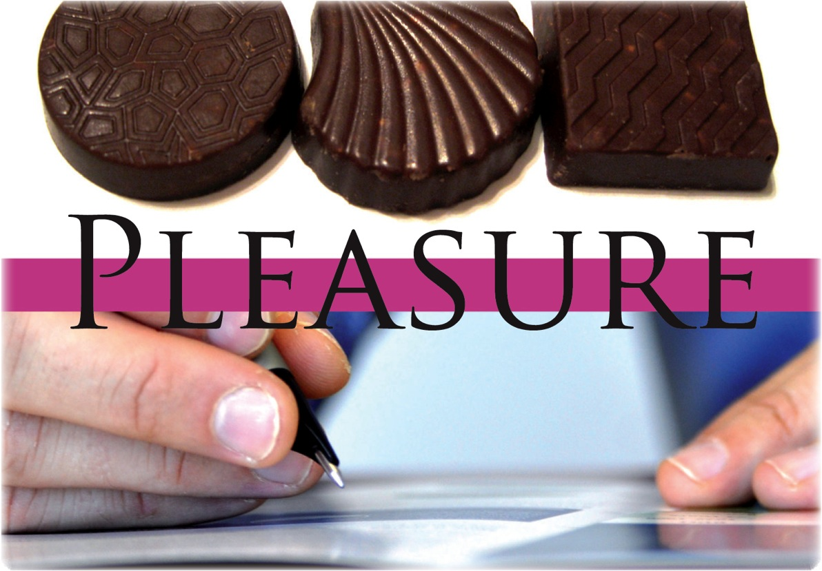
A path away from gluttony
Notes:
Pages 48-55 of The 3 Colors of Community contain the teaching associated with this slide.

Slide 20
A path away from Gluttony
effective structures
effective structures
pleasure
gluttony

Slide 21
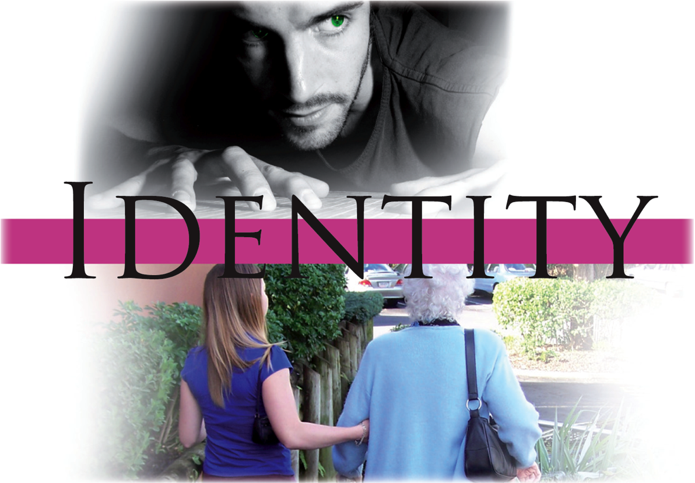
A path away from envy
Notes:
Pages 56-63 of The 3 Colors of Community contain the teaching associated with this slide.

Slide 22
A path away from Envy
gift-based ministry
gift-based ministry
identity
envy

Slide 23
A path away from greed
Notes:
Pages 64-71 of The 3 Colors of Community contain the teaching associated with this slide.

Slide 24
A path away from greed
need-oriented evangelism
need-oriented evangelism
sustenance
greed

Slide 25
A path away from anger
Notes:
Pages 72-79 of The 3 Colors of Community contain the teaching associated with this slide.

Slide 26
A path away from Anger
loving relationships
loving relationships
justice
anger

Slide 27
A path away from sloth
Notes:
Pages 80-87 of The 3 Colors of Community contain the teaching associated with this slide.

Slide 28
A path away from Sloth
passionate spirituality
passionate spirituality
renewal
sloth

Slide 29
A path away from lust
Notes:
Pages 88-95 of The 3 Colors of Community contain the teaching associated with this slide.

Slide 30
A path away from Lust
inspiring worship
inspiring worship
intimacy
lust

Slide 31
The Communal Test
Vulnerability: Pride
Energy for: Empowering leadership
Vulnerability: Gluttony
Energy for: Effective structures
Vulnerability: Envy
Energy for: Gift-based ministry
Vulnerability: Greed
Energy for: Need-oriented evangelism
Vulnerability: Anger
Energy for: Loving relationships
Vulnerability: Sloth
Energy for: Passionate spirituality
Vulnerability: Lust
Energy for: Inspiring worship
power
Always start with your
strongest energy
pleasure
identity
sustenance
justice
renewal
intimacy
intimacy
Notes:
Pages 96-106 of The 3 Colors of Community contain the teaching associated with this slide.

Slide 32
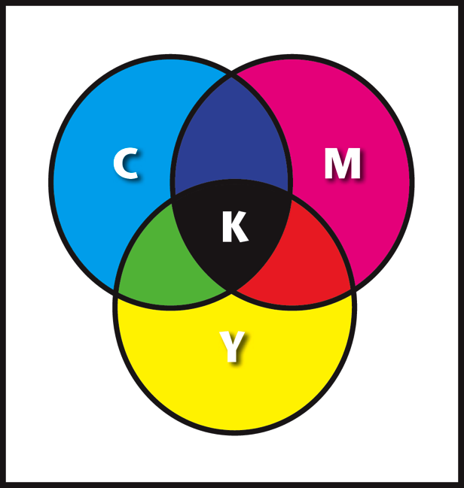
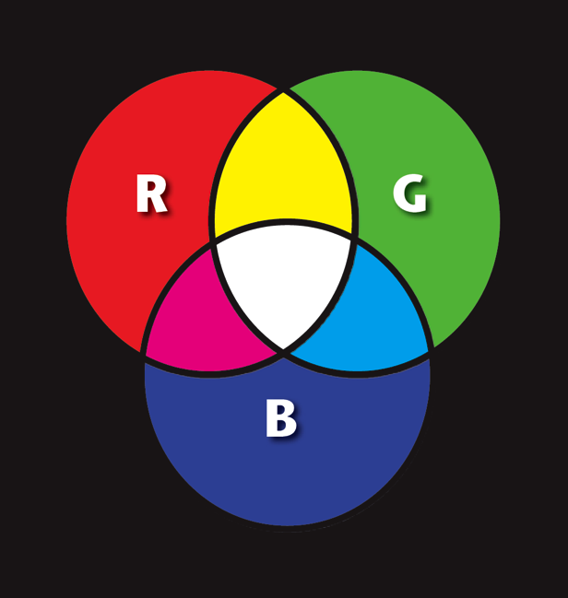
Sin as the absence of light
Object colors
The colors of light
Notes:
Pages 108-111 of The 3 Colors of Community contain the teaching associated with this slide.

Slide 33
Addressing the deadly sins within a small group
Vulnerability: Pride
Energy for: Empowering leadership
Vulnerability: Gluttony
Energy for: Effective structures
Vulnerability: Envy
Energy for: Gift-based ministry
Vulnerability: Greed
Energy for: Need-oriented evangelism
Vulnerability: Anger
Energy for: Loving relationships
Vulnerability: Sloth
Energy for: Passionate spirituality
Vulnerability: Lust
Energy for: Inspiring worship
power
pleasure
identity
sustenance
justice
renewal
intimacy
Notes:
Pages 112-116 of The 3 Colors of Community contain the teaching associated with this slide.

Slide 34
Addressing the deadly sins within a small group
A group with strong head energies (green)
A group with strong head-hands energies (green-red)
A group with strong hands energies (red)
A group with strong heart-hands energies (blue-red)
A group with strong heart energies (blue)
A group with strong head-heart energies (green-blue)

Slide 35
Spiritual Change Talk
Experimentation questions
Experimentation questions
Test
Test
Understand
Perceive
Understand
Perceive
Vision questions
Vision questions
Capacity questions
Capacity questions
Spiritual Change
Prioritize
Experience
Prioritize
Experience
Strategy questions
Progression questions
Strategy questions
Progression questions
Do
Do
Training questions
Training questions

Slide 36
Identifying the different voices within you
Proud Voice
“My concepts are superior to others”
Empowering Voice
“I am committed to empowering other people”
Voice 1
Voice 2
IDENTIFICATION
This voice is part of me…
…but it is only part of me
DISIDENTIFICATION
Inner Voice

Slide 37
Identifying the different voices within you
The anointed one
God has called me to be an international leader
David
I am proud of my own anti-status-symbols approach
Laid-back
People are old enough to make their own decisions
The anointed one
Coach
“My measure of success is the maturity of my coachees”
Empower-er
I am committed to help others fulfill their visions
“David”
Laid-back
Coach
Empower
people
Network Leader
“Our approach to leadership is far superior to others”
Bible student
I am committed to empowering
other people
Network Leader
Inner Voice
Bible student

Slide 38
Identifying the different voices within you
The anointed one
God has called me to be an international leader
David
I am proud of my own anti-status-symbols approach
Laid-back
People are old enough to make their own decisions
The anointed one
Coach
“My measure of success is the maturity of my coachees”
Pride
Empowering Leadership
Empower-er
I am committed to help others fulfill their visions
“David”
Laid-back
Coach
Empower
people
Network Leader
“Our approach to leadership is far superior to others”
Bible student
I am committed to empowering
other people
Network Leader
Inner Voice
Bible student

Slide 39
Identifying the different voices within you

Slide 40
Establishing more holistic groups
Effective structures
head
Inspiring worship
Gift-based ministry
Empowering leadership
Passionate
spirituality
Need-oriented evangelism
heart
hands
Loving relationships

Slide 41
Christian community — a glimpse of heaven
HEAVEN
GOOD
LIFE
sin
sickness
EVIL
DEATH
HELL

Slide 42
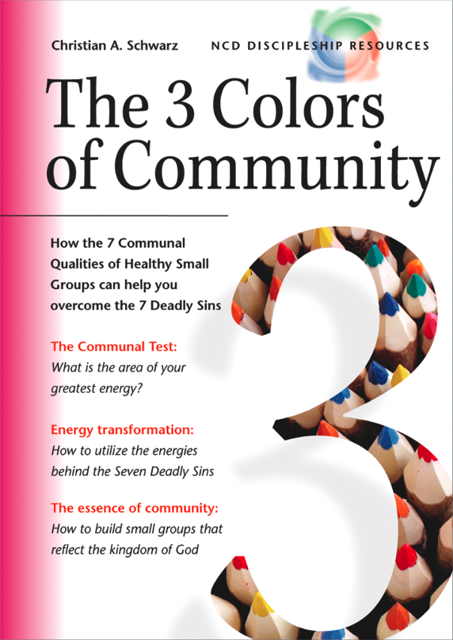
Notes:
The cover of The 3 Colors of Community.

Slide 43
ncd.life

