Slide 1
The 3 Colors of Your empowering leadership
Topic: empowerment

Slide 2
Dear presenter, This PowerPoint serves as a master file for creating your own tailored presentations. It’s not designed to be presented from start to finish unless it uniquely suits your audience.
When customising your presentation, consider:
Your audience’s specific needs
Your level of influence with them
The time available (aim for one slide per 5–10 minutes, including Q&A)
Potential distractions in the environment
Slide notes include page references from The 3 Colors of Your Spirituality for preparation. Also, be ready to share personal stories from your experience with the material.
Thank you for your valuable ministry!
Blessings ncd.life

Slide 3
The focus of the Empowerment Test
Notes:
Pages 10-13 of The 3 Colors of Leadership contain the teaching associated with this slide.

Slide 4
Empowering—or only powerful?
I lead
I lead
I lead
C
C
C
D
D
D
I don’t empower
I don’t empower
I don’t empower
I don’t empower
I empower
I empower
I empower
I empower
A
A
A
B
B
B
B
I don’t lead
I don’t lead
I don’t lead
Notes:
Pages 14-17 of The 3 Colors of Leadership contain the teaching associated with this slide.

Slide 5
A radical change of perspective
Measures to achieve a result
Results
A
B
money (amount)
workers (number)
infrastructure (size)
Mature people who have discovered and live out their own visions
Notes:
Pages 18-20 of The 3 Colors of Leadership contain the teaching associated with this slide.

Slide 6
The three dimensions of leadership
explanation
Teach the principles
liberation
motivation
Permit mistakes
Focus on strengths
Notes:
Pages 21-25 of The 3 Colors of Leadership contain the teaching associated with this slide.

Slide 7
Three misdirected roles
expert
misdirected role
comrade
driver
misdirected role
misdirected role
Notes:
Pages 21-25 of The 3 Colors of Leadership contain the teaching associated with this slide.

Slide 8
Wing traits needed
empowering wing
Teach the principles
Nurture steady progress
Analyze present situation
Assess weaknesses
Learn from mistakes
empowering wing
Release vision of others
Cast a vision
leading wing
Permit mistakes
Focus on strengths
Advocate bold moves
Set goals
leading wing
Model the principles
Notes:
Pages 26-29 of The 3 Colors of Leadership contain the teaching associated with this slide.

Slide 9
Wing traits needed
Vision
Release vision of others
Cast a vision
Experimentation
Permit mistakes
Learn from mistakes
Capacity
Assess weaknesses
Focus on strengths
Strategy
Analyze present situation
Set goals
Training
Teach the principles
Model the principles
Progression
Nurture steady progress
Advocate bold moves
Notes:
Pages 26-29 of The 3 Colors of Leadership contain the teaching associated with this slide.

Slide 10
The secret: character plus gifting plus training
plus
gifting
plus
training
Effective Leadership
Character
Notes:
Pages 30-32 of The 3 Colors of Leadership contain the teaching associated with this slide.

Slide 11
Empowerment: Producing more leaders
“traditional approach”
Followers as helpers of the leader.
NCD approach
Empowering leadership resulting in ongoing leadership multiplication.
Notes:
Pages 33-35 of The 3 Colors of Leadership contain the teaching associated with this slide.

Slide 12
NCD Davids—the true movers and shakers
Quantitative research
65,000
churches
as distanced and objective as possible
Qualitative research
2 samples of 25 leaders each
objective and subjective elements
Learning by participation
18 years of intercultural ministry
observations in actual ministry situations
Notes:
Pages 36-40 of The 3 Colors of Leadership contain the teaching associated with this slide.

Slide 13
The Empowerment Test
Empowering wing
Leading wing
Vision
Release vision of others
6
Cast a vision
Capacity
Assess weaknesses
5
Focus on strengths
Experimentation
Permit mistakes
4
Learn from mistakes
Progression
Nurture steady progress
3
Advocate bold moves
Training
Teach the principles
2
Model the principles
Strategy
Analyze present situation
1
Set goals
Notes:
Pages 42-45 of The 3 Colors of Leadership contain the teaching associated with this slide.

Slide 14
Understanding the results
Empowering leadership
Strategy
Experimentation
Progression
Vision
Training
Capacity
Development of wing traits
Notes:
Pages 46-50 of The 3 Colors of Leadership contain the teaching associated with this slide.

Slide 15
Understanding the results
Empowering wing
Leading wing
Assessment of the balance between the leading wing and the empowering wing
Strong in explanation, weak in motivation and liberation
Strong in explanation and motivation, weak in liberation
Strong in motivation, weak in explanation and liberation
Strong in motivation and liberation, weak in explanation
Strong in liberation, weak in explanation and motivation
Strong in explanation and liberation, weak in motivation
Notes:
Pages 46-50 of The 3 Colors of Leadership contain the teaching associated with this slide.

Slide 16
The two wings of vision
Teach the principles
Teach the principles
Nurture steady progress
Analyze present situation
Nurture steady progress
Analyze present situation
explanation
Learn from mistakes
Assess weaknesses
Learn from mistakes
Assess weaknesses
Cast a vision
Release vision of others
Cast a vision
Release vision of others
liberation
motivation
Permit mistakes
Permit mistakes
Focus on strengths
Focus on strengths
Advocate bold moves
Advocate bold moves
Set goals
Set goals
Model the principles
Model the principles
Notes:
Pages 51-58 of The 3 Colors of Leadership contain the teaching associated with this slide.

Slide 17
The two wings of experimentation
Teach the principles
Teach the principles
Nurture steady progress
Analyze present situation
Nurture steady progress
Analyze present situation
explanation
Learn from mistakes
Assess weaknesses
Learn from mistakes
Assess weaknesses
Cast a vision
Release vision of others
Cast a vision
Release vision of others
liberation
motivation
Permit mistakes
Permit mistakes
Focus on strengths
Focus on strengths
Advocate bold moves
Advocate bold moves
Set goals
Set goals
Model the principles
Model the principles
Notes:
Pages 59-66 of The 3 Colors of Leadership contain the teaching associated with this slide.

Slide 18
The two wings of capacity
Teach the principles
Teach the principles
Nurture steady progress
Analyze present situation
Nurture steady progress
Analyze present situation
explanation
Learn from mistakes
Assess weaknesses
Learn from mistakes
Assess weaknesses
Cast a vision
Release vision of others
Cast a vision
Release vision of others
liberation
motivation
Permit mistakes
Permit mistakes
Focus on strengths
Focus on strengths
Advocate bold moves
Advocate bold moves
Set goals
Set goals
Model the principles
Model the principles
Notes:
Pages 67-74 of The 3 Colors of Leadership contain the teaching associated with this slide.

Slide 19
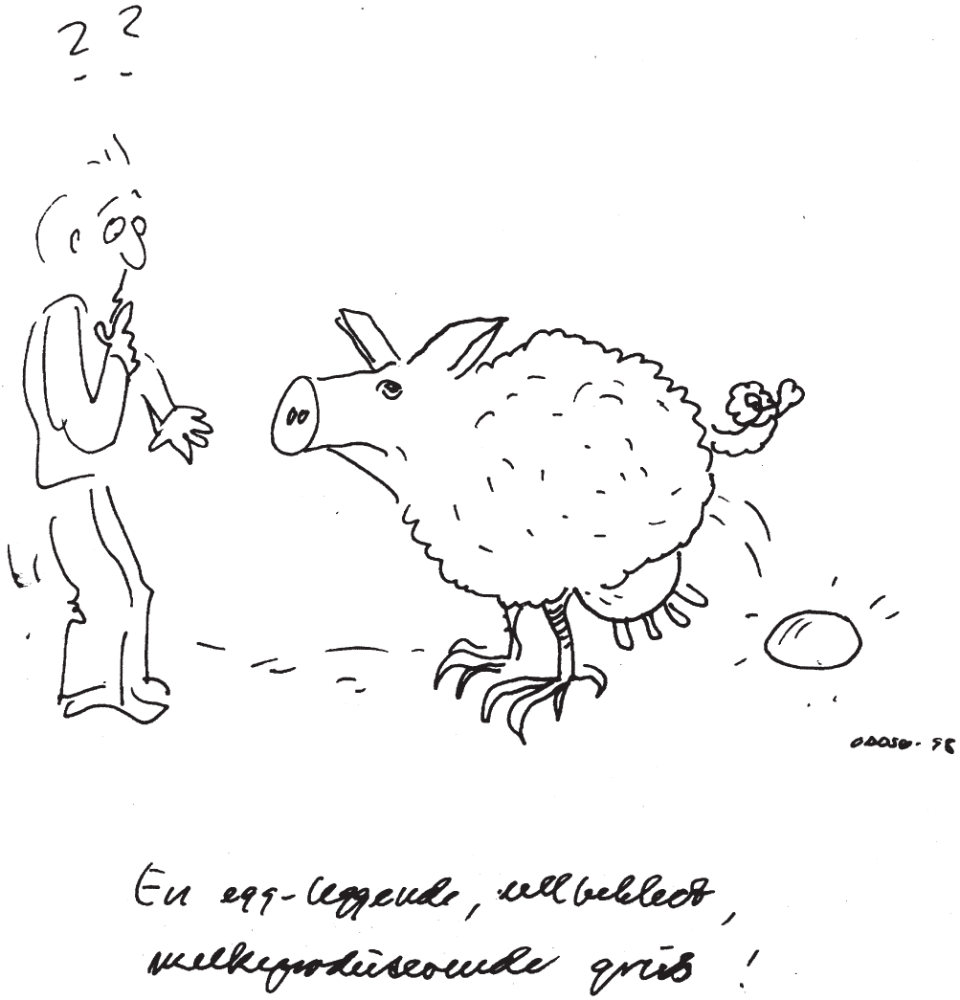
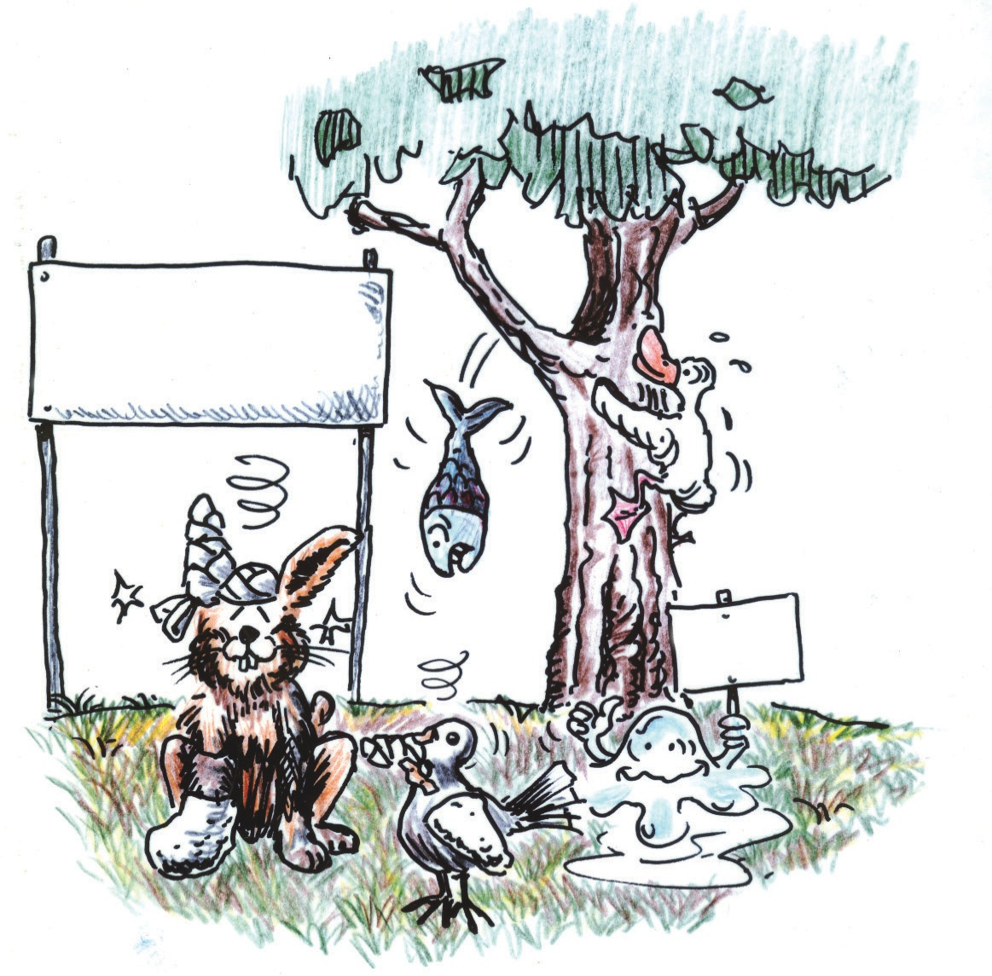
The two wings of capacity
The Animal School
Class Winner
Notes:
Pages 67-74 of The 3 Colors of Leadership contains the teaching associated with this slide.

Slide 20
The two wings of strategy
Teach the principles
Teach the principles
Nurture steady progress
Analyze present situation
Nurture steady progress
Analyze present situation
explanation
Learn from mistakes
Assess weaknesses
Learn from mistakes
Assess weaknesses
Cast a vision
Release vision of others
Cast a vision
Release vision of others
liberation
motivation
Permit mistakes
Permit mistakes
Focus on strengths
Focus on strengths
Advocate bold moves
Advocate bold moves
Set goals
Set goals
Model the principles
Model the principles
Notes:
Pages 75-82 of The 3 Colors of Leadership contains the teaching associated with this slide.

Slide 21
The two wings of training
Teach the principles
Teach the principles
Nurture steady progress
Analyze present situation
Nurture steady progress
Analyze present situation
explanation
Learn from mistakes
Assess weaknesses
Learn from mistakes
Assess weaknesses
Cast a vision
Release vision of others
Cast a vision
Release vision of others
liberation
motivation
Permit mistakes
Permit mistakes
Focus on strengths
Focus on strengths
Advocate bold moves
Advocate bold moves
Set goals
Set goals
Model the principles
Model the principles
Notes:
Pages 83-90 of The 3 Colors of Leadership contain the teaching associated with this slide.

Slide 22
The two wings of progression
Teach the principles
Teach the principles
Nurture steady progress
Analyze present situation
Nurture steady progress
Analyze present situation
explanation
Learn from mistakes
Assess weaknesses
Learn from mistakes
Assess weaknesses
Cast a vision
Release vision of others
Cast a vision
Release vision of others
liberation
motivation
Permit mistakes
Permit mistakes
Focus on strengths
Focus on strengths
Advocate bold moves
Advocate bold moves
Set goals
Set goals
Model the principles
Model the principles
Notes:
Pages 91-98 of The 3 Colors of Leadership contain the teaching associated with this slide.

Slide 23
What Spiritual Change Talk is all about
information
Test
Perceive
Understand
Experience
Prioritize
transformation
application
Do
Notes:
Pages 100-105 of The 3 Colors of Leadership contain the teaching associated with this slide.

Slide 24
What Spiritual Change Talk is all about
Notes:
Pages 100-105 of The 3 Colors of Leadership contain the teaching associated with this slide.

Slide 25
What Spiritual Change Talk is all about
Experimentation questions
Experimentation questions
Test
Test
Understand
Perceive
Understand
Perceive
Vision questions
Vision questions
Capacity questions
Capacity questions
Trainee’s growth
Prioritize
Experience
Prioritize
Experience
Strategy questions
Progression questions
Strategy questions
Progression questions
Do
Do
Training questions
Training questions
Notes:
Pages 100-105 of The 3 Colors of Leadership contain the teaching associated with this slide.

Slide 26
Small group and larger group volume discounts apply on the book.
Or you can get started straight away by taking the online eTest.
See the web site for details.
Notes:
The cover of The 3 Colors of Leadership.

Slide 27
ncd.life

